Slide 1

TECHNICAL BRIEFING
FROM RADAR TO MULTI-INT FUSION
ADS-B, AIS, and the Detection of Dark Targets
Gene Soudlenkov, GNZ, 2025
Notes:
Goal: Set the professional and technical tone for the briefing.
Notes: State that the briefing focuses on the evolution of surveillance intelligence, moving from traditional primary radar (PR) to modern multi-intelligence (Multi-INT) fusion methods, specifically leveraging cooperative data sources like ADS-B and AIS to find non-cooperative, or "dark," targets.

Slide 2


Mission Objectives
01 // History
02 // Intelligence
Understand the physics of early Radar, the IFF problem, and the origin of "Squawking."
Analyze military applications, OSINT vulnerabilities, and the "Ghost Fleet" phenomenon.
03 // The Dark Layer
04 // Fusion
Detecting non-cooperative targets in Air vs. Maritime domains using sensor fusion.
Demonstrate the strategic value of fusing Air (ADS-B) and Sea (AIS) data.
Notes:
History: We start with the fundamentals—how basic radar works, the introduction of the IFF challenge, and the origin of current cooperative systems.
Intelligence: We'll analyze the current vulnerabilities of these systems, such as their use in Open-Source Intelligence (OSINT), and the phenomena like the maritime "Ghost Fleet."
The Dark Layer: This is the ultimate objective: how to apply fusion techniques to detect and track entities that have deliberately turned off their cooperative transmitters in both air and maritime domains.
Fusion: We will conclude by demonstrating the strategic value of correlating seemingly disparate data streams (Air and Sea) to achieve a complete Common Operating Picture (COP).

Slide 3
SECTION 1
THE HISTORICAL FOUNDATION
Skin Paints, Echoes, and the Birth of IFF
Notes:
This section grounds us in the fundamental physics that govern all modern surveillance systems, starting with the very first electronic eyes on the battlefield.

Slide 4
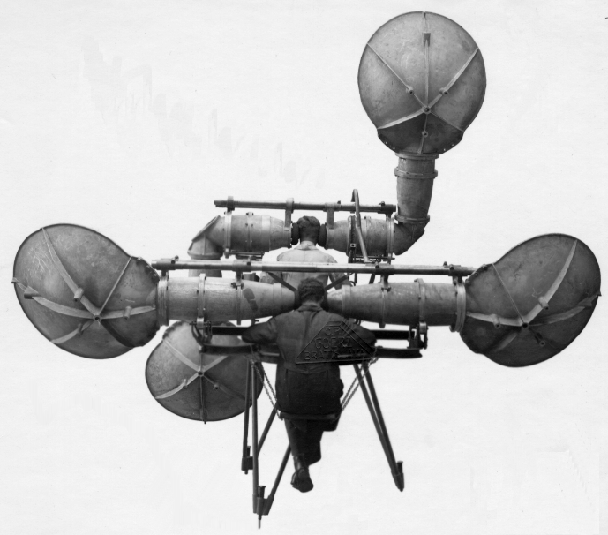
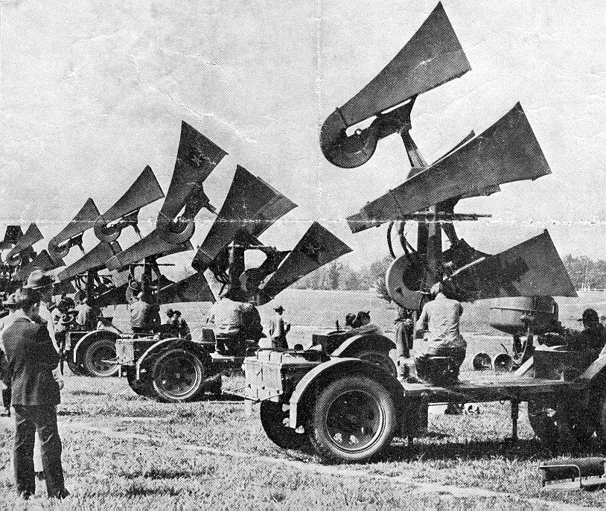
1915-1940s: Aeroacoustics – early devices
Supplement to visual means for the artillery
Usually contain four sound-absorbing elements, such as curved shells or horns that are used in pairs. Two elements at a fixed mutual distance were adjustable in the horizontal plane for the determination of the map angle. The other two shells or horns could be adjusted in the vertical plane to measure the elevation
- The detection of unseen incoming aircraft was a major problem
- After a sound contact was made, laborious calculations were then required
- It was the only system available for detecting the approach of unseen aircraft until the development of radar in the 1930
- According to the Imperial War Museums, this device had a maximum accuracy of 1/10 of a degree
Notes:
Since WW1 it had been realised that the threat of attack by air was very real. In WW1 the UK had suffered over fifty bombing raids from German Zeppelin airships, and later Gotha bomber aircraft, on London, Great Yarmouth, Ramsgate and others, with a total of 1,392 civilian dead and 3,330 injured, and it was evident that there was no effective means of providing early warning against such raids. The earliest attempts used a network of observers, and acoustic techniques based on large horns or reflectors, but these only worked at all when conditions were optimal. The pictures below show some schemes of this kind.
Everything cooperating, the aircraft would probably be heard 8 miles away, could, infrequently be heard at sixteen miles, and the record for the course was about twenty-four – I do not know that the Big Ear ever detected a wholly unexpected aircraft approaching from the most favourable direction at this latter range. All this was, moreover, conditional on the visitor keeping to the fairway.

Slide 5
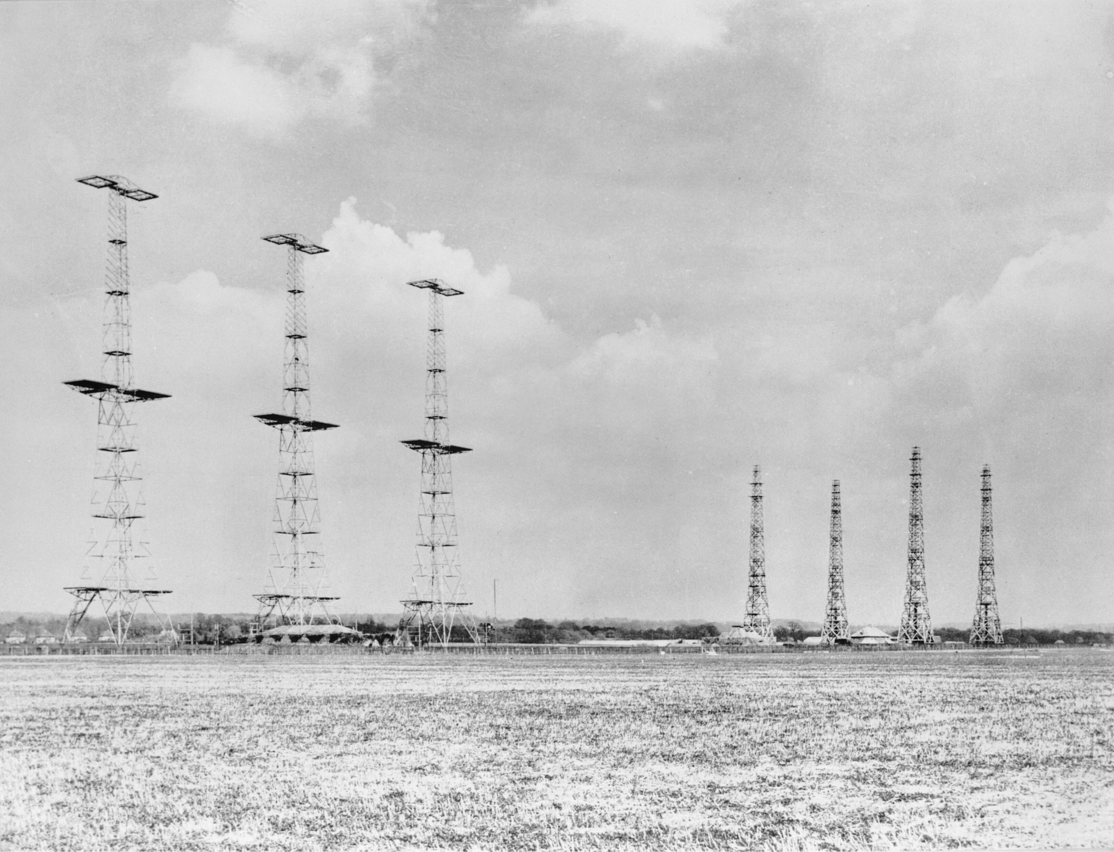
1935: The Dawn of Radar
RADAR: Radio Detection and Ranging
Chain Home Network
Before rotating dishes, massive stationary towers "floodlit" the sky with radio energy.
>
Physics: High Frequency (HF) radio waves (20-30 MHz).
>
Concept: Sending a pulse and measuring the time it takes to bounce back.
>
Detection: The "Skin Paint." The raw reflection of RF energy off the metal skin of an aircraft.
Notes:
Chain Home: These were the first operational radar systems. They were fundamentally different from modern rotating dishes. They were massive, stationary transmitters that "floodlit" an area with radio waves.
Physics: They used High Frequency (HF) radio waves. Detection relied purely on the energy being reflected back from the metal skin of the aircraft—the "Skin Paint."
Limitation: It only provided range and bearing; it offered no information about the identity or intent of the target.

Slide 6
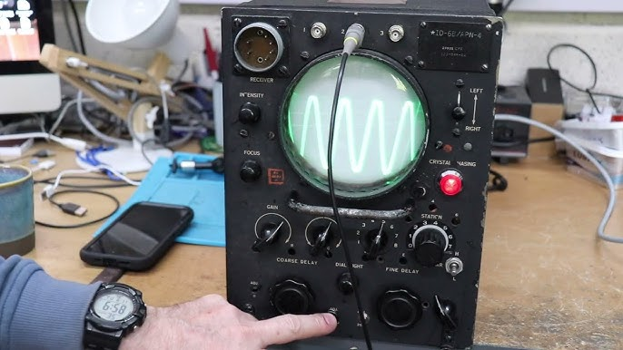

The A-Scope & The "Blip"
Interpreting the Echo
Early operators didn't see a map. They saw a pulsing line on a Cathode Ray Tube (CRT).
Range Calculation
Distance = (Time × Speed of Light) / 2
A "blip" further to the right meant the target was further away.
Notes:
Early operators didn't have the nice circular Plan Position Indicators (PPIs) we see today. They used the A-Scope , which was a simple Cathode Ray Tube (CRT).
Pulse & Blip: The initial pulse created a spike on the left of the screen. Any reflected energy (an echo or "blip") appeared further to the right.
Range Calculation: The distance to the target was calculated by measuring the time delay between the initial transmission and the received echo, using the fundamental formula: Distance = (Time × Speed of Light) / 2.

Slide 7


Primary Surveillance Radar (PSR)
>
Primary Surveillance Radar (PSR) Non-Cooperative. The direct descendant of Chain Home. The "Safety Net."
Notes:
Goal: Define the three layers of modern air surveillance.
Today, Air Traffic Management relies on three concurrent systems:
Primary Surveillance Radar (PSR): The original "skin paint." It's the ultimate non-cooperative safety net—if all else fails, PSR will still see the physical object.
Secondary Surveillance Radar (SSR): The evolution of IFF. It is cooperative; the interrogator (ground radar) sends a 1030MHz signal, and the transponder replies at 1090MHz with a coded response.
ADS-B (Automatic Dependent Surveillance–Broadcast): The newest layer. The aircraft calculates its own position via GPS and automatically broadcasts it multiple times per second, removing the need for radar interrogation.

Slide 8
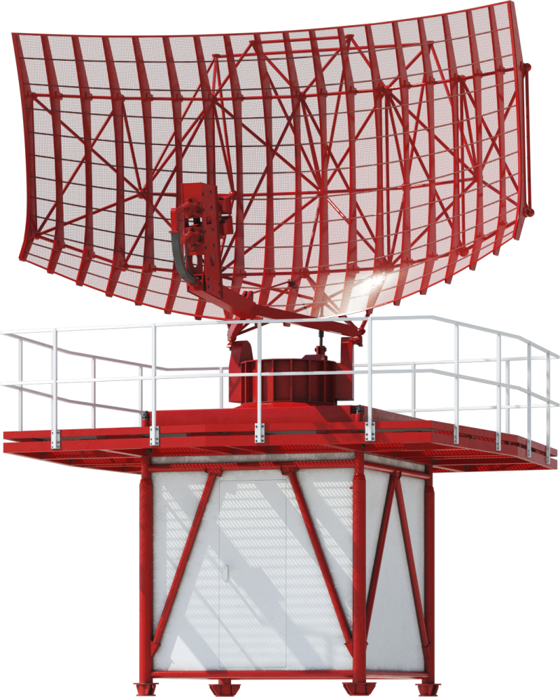
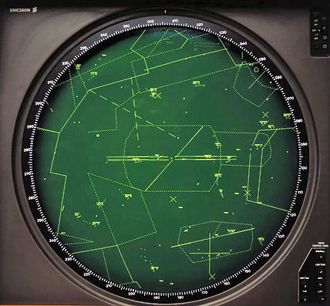
Primary Surveillance Radar (PSR)
Only basic information is available
Limited by distance, weather, size of the target
Cone of silence reduces the efficiency of operations
-
Notes:
Goal: Define the three layers of modern air surveillance.
Today, Air Traffic Management relies on three concurrent systems:
Primary Surveillance Radar (PSR): The original "skin paint." It's the ultimate non-cooperative safety net—if all else fails, PSR will still see the physical object.
Secondary Surveillance Radar (SSR): The evolution of IFF. It is cooperative; the interrogator (ground radar) sends a 1030MHz signal, and the transponder replies at 1090MHz with a coded response.
ADS-B (Automatic Dependent Surveillance–Broadcast): The newest layer. The aircraft calculates its own position via GPS and automatically broadcasts it multiple times per second, removing the need for radar interrogation.

Slide 9



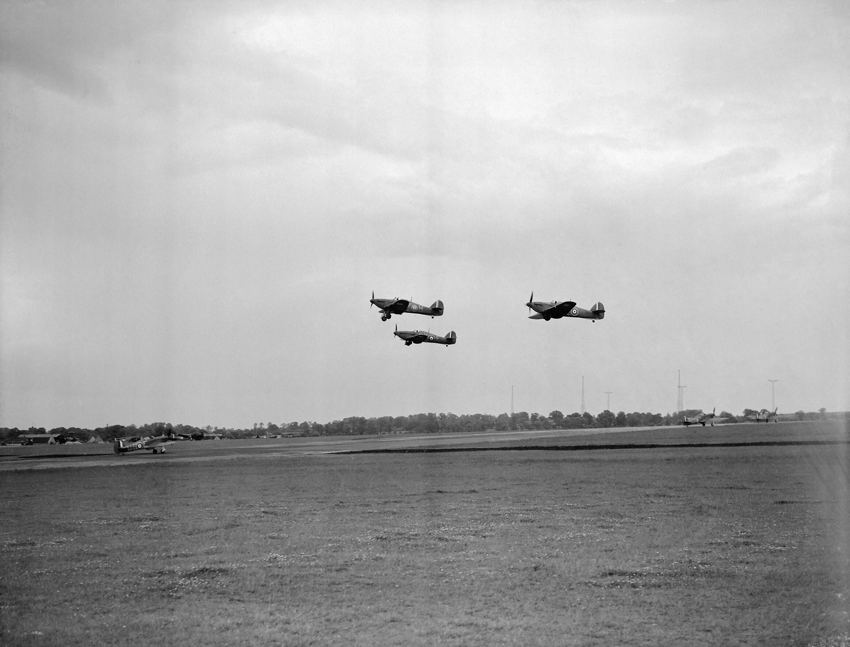
Identity Crisis: The IFF Problem
The Problem
The Solution
The Transponder
Radar is blind to intent. An enemy bomber and a friendly fighter look identical as "blips" on an A-Scope.
I.F.F. (Identification Friend or Foe). We needed the aircraft to cooperate.
A portmanteau of Transmitter-Responder. A device that listens for a radar pulse and fires back a distinct signal.
A flight of Hawker Hurricane Mark Is of No. 151 Squadron RAF take off from North Weald, Essex, while beneath them, Hurricanes of 56 Squadron RAF taxy to the northern end of the main runway. Behind them can be seen the wireless masts of the GPO radio station at Weald Gullet.
Barking Creek, England
September 6, 1939
1 pilot killed
1 Hawker Hurricane destroyed
1 Supermarine Spitfire destroyed
Notes:
Goal: Define the problem that necessitated cooperative surveillance systems.
Notes:
The Crisis: Primary Radar (PSR) is non-cooperative—it detects anything that reflects RF energy. In combat, a "blip" meant a target, but it offered no identification, leading to "friendly fire" incidents.
The Solution: IFF: This led to the development of IFF (Identification Friend or Foe)
The Transponder: This portmanteau device is the core of modern cooperative systems. It receives the radar interrogation pulse and transmits a unique coded response.

Slide 10
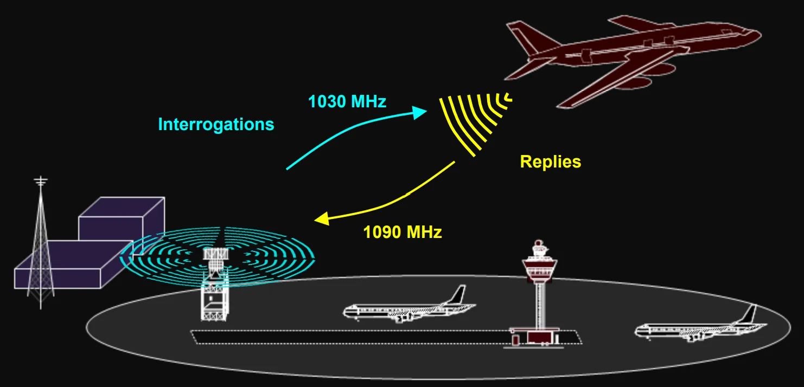
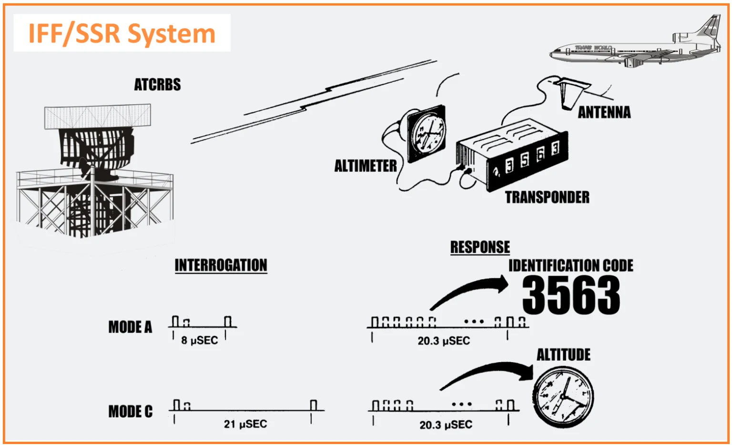
IFF/SSR system
The primary purpose of the SSR system is to locate, separate, and identify aircraft. This involves employing radar-like techniques to determine the aircraft’s location and employing communication-like techniques to identify and differentiate between aircraft.
Directional Antenna: The system utilizes directional antennas to broadcast interrogations (requests for information) and receive replies from aircraft.
Time of Transmission-Return: By measuring the time it takes for the transmitted signal to return, the system can calculate the range (distance) to the aircraft.
Direction of Antenna: The azimuth (horizontal angle) of the antenna is used to determine the direction from which the aircraft’s signal is coming, aiding in locating the aircraft.
Notes:
Goal: Define the three layers of modern air surveillance.
Today, Air Traffic Management relies on three concurrent systems:
Primary Surveillance Radar (PSR): The original "skin paint." It's the ultimate non-cooperative safety net—if all else fails, PSR will still see the physical object.
Secondary Surveillance Radar (SSR): The evolution of IFF. It is cooperative; the interrogator (ground radar) sends a 1030MHz signal, and the transponder replies at 1090MHz with a coded response.
ADS-B (Automatic Dependent Surveillance–Broadcast): The newest layer. The aircraft calculates its own position via GPS and automatically broadcasts it multiple times per second, removing the need for radar interrogation.

Slide 11


Operation Parrot: "Squawk Your Mode"
The Code Name
Legacy Today
In WWII, the secret IFF transponder was codenamed "Parrot."
We still use this terminology 80 years later.
>
"Squawk Your Parrot": Command to turn the transponder on.
"Charlie Bravo Delta, Squawk 5535, ident"
>
"Strangle Your Parrot": Command to turn it off (EMCON).
Means: Set your transponder to code 5535 and press Ident button.
>
"Sweet/Sour": Valid/Invalid response.
Notes:
The original secret IFF transponder used by Allied forces in WWII was codenamed the "Parrot."
This led to the familiar commands still used by Air Traffic Control today:
"Squawk Your Parrot" became simply "Squawk"—meaning, turn on your transponder.
"Strangle Your Parrot" meant turn it off (Emission Control or EMCON).
Even when a pilot is instructed to "Squawk 7700" (the emergency code), they are using terminology directly descended from this WWII code name.

Slide 12
Secondary Surveillance Radar (SSR)
>
Primary Surveillance Radar (PSR) Non-Cooperative. The direct descendant of Chain Home. The "Safety Net."
>
Secondary Surveillance Radar (SSR) Cooperative. The evolution of IFF. Interrogator sends 1030MHz, Transponder replies 1090MHz.
Notes:
Goal: Define the three layers of modern air surveillance.
Today, Air Traffic Management relies on three concurrent systems:
Primary Surveillance Radar (PSR): The original "skin paint." It's the ultimate non-cooperative safety net—if all else fails, PSR will still see the physical object.
Secondary Surveillance Radar (SSR): The evolution of IFF. It is cooperative; the interrogator (ground radar) sends a 1030MHz signal, and the transponder replies at 1090MHz with a coded response.
ADS-B (Automatic Dependent Surveillance–Broadcast): The newest layer. The aircraft calculates its own position via GPS and automatically broadcasts it multiple times per second, removing the need for radar interrogation.

Slide 13
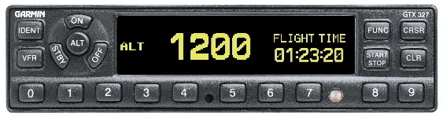
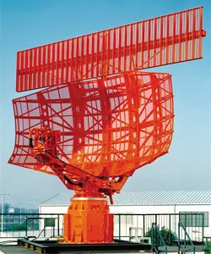
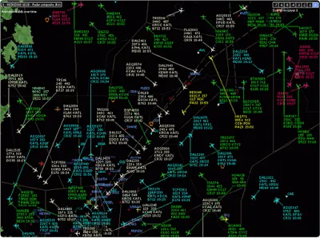
Transponders – parrots squawking
Three distinct modes:
>
Mode A (Alpha): Transmit squawk only
>
Mode C (Charlie): Transmit squawk and pressure altitude
>
Mode S (Sierra): Allows for selective interrogation of individual aircraft using a unique 24-bit address assigned to each airframe
Notes:
The original secret IFF transponder used by Allied forces in WWII was codenamed the "Parrot."
This led to the familiar commands still used by Air Traffic Control today:
"Squawk Your Parrot" became simply "Squawk"—meaning, turn on your transponder.
"Strangle Your Parrot" meant turn it off (Emission Control or EMCON).
Even when a pilot is instructed to "Squawk 7700" (the emergency code), they are using terminology directly descended from this WWII code name.

Slide 14
Mode S features
Selective interrogation
Datalink – enhanced data
transfer
Datalink – enhanced data
transfer
Unique identification
Mode S ground stations can address specific aircraft individually
- Automatic reporting of aircraft identity (call sign).
- Altitude reporting in precise 25-foot increments.
- Aircraft intent data like selected altitude, heading, ground speed, and vertical rate (with Enhanced - Surveillance or EHS).
Each aircraft is assigned a permanent, unique 24-bit International Civil Aviation Organization (ICAO) address, which is transmitted in every reply and allows for unambiguous identification.
Collision avoidance integration
Operational benefits
Collision avoidance integration
Operational benefits (cont)
- Improved Situational Awareness: Controllers receive a clearer, more accurate air situation picture, with fewer identification errors and enhanced tracking capabilities.
- Increased Airspace Capacity: The ability to handle more targets simultaneously and efficiently manage a greater volume of data helps manage high-traffic density airspace.
- Reduced Radio (R/T) Workload: The automatic downlinking of data reduces the need for constant voice communication between pilots and controllers to confirm information like headings and altitudes.
- Enhanced Safety Nets: The high integrity and detailed data improve the performance of safety alert systems (like Short Term Conflict Alert), reducing false alarms and improving the ability to detect potential conflicts.
Mode S is a foundational component for Airborne Collision Avoidance Systems (ACAS) and Traffic Alert and Collision Avoidance Systems (TCAS), facilitating direct air-to-air data exchange between equipped aircraft to prevent mid-air collisions.
Notes:
Goal: Define the problem that necessitated cooperative surveillance systems.
Notes:
The Crisis: Primary Radar (PSR) is non-cooperative—it detects anything that reflects RF energy. In combat, a "blip" meant a target, but it offered no identification, leading to "friendly fire" incidents.
The Solution: IFF: This led to the development of IFF (Identification Friend or Foe)
The Transponder: This portmanteau device is the core of modern cooperative systems. It receives the radar interrogation pulse and transmits a unique coded response.

Slide 15

Operational Limitations of Radar
The "Blind Spots"
Enter ADS-B
Traditional SSR requires Line-of-Sight (LOS). It fails in critical domains:
By decoupling surveillance from ground stations and using GNSS:
>
Oceanic: HF voice reports were the only method.
>
Remote Terrain: Mountains block radar pulses.
> Update Rate: ~0.5 Hz (2x/sec) > Accuracy: < 0.05 NM > Cost: 1/10th of Radar > Coverage: Global
>
Update Rate: Mechanical rotation (5-12s) is too slow for modern tactical separation.
>
Range: 60–80 NM typical
>
Limitation: Cannot identify aircraft
>
Limitation: No altitude data
>
Limitation: Echo strength depends on aircraft size/material
>
Limitation: Expensive infrastructure
Notes:
Highlight why ADS-B was necessary despite the existence of PSR and SSR.
Both traditional PSR and SSR are fundamentally limited by Line-of-Sight (LOS) propagation.
Blind Spots: They fail over the vast, open ocean, remote mountainous areas, and low altitudes.
Update Rate: Mechanical rotation limits the update rate to 5-12 seconds, which is too slow for modern high-density traffic.
ADS-B Solves This: By broadcasting position via GPS, ADS-B provides a massive leap in update rate (0.5 Hz or 2x/sec), accuracy, and global coverage at a fraction of the cost of installing new ground-based radar.

Slide 16
Radar FRUIT
Interference
Source of the problem
How interference occurs
Caused by “False Replies Unsynchronised to Interrogator Transmissions”
In secondary radar systems (like those used for air traffic control), a ground station interrogates an aircraft's transponder, which then replies.
When many radars are active and there is high air traffic, one radar's signal can trigger a response from an aircraft's transponder that is not intended for that radar.
Why FRUIT
Impact
Context
This interference can cause false targets on the radar screen, and to combat it, radar systems use a "defruiter" filter to block unsynchronized replies.
This phenomenon is a common issue in air traffic control and has led to the development of more advanced radar systems, such as Mono-pulse Secondary Surveillance Radar (MSSR), which are better at filtering out FRUIT.
Acronym is officially False Replies Unsynchronised In Time (or Interrogator Transmissions). The replies are considered "false" because they are not synchronized with the radar's own interrogation signal.
Notes:
Goal: Define the problem that necessitated cooperative surveillance systems.
Notes:
The Crisis: Primary Radar (PSR) is non-cooperative—it detects anything that reflects RF energy. In combat, a "blip" meant a target, but it offered no identification, leading to "friendly fire" incidents.
The Solution: IFF: This led to the development of IFF (Identification Friend or Foe)
The Transponder: This portmanteau device is the core of modern cooperative systems. It receives the radar interrogation pulse and transmits a unique coded response.

Slide 17
SECTION 2
ADS-B ARCHITECTURE
Notes:
Goal: Transition to the technical details of the ADS-B system.
Notes: We now move into how ADS-B actually works—its frequencies, its infrastructure, and the core concept of its operation.

Slide 18
The Modern Triad
>
Primary Surveillance Radar (PSR) Non-Cooperative. The direct descendant of Chain Home. The "Safety Net."
>
Secondary Surveillance Radar (SSR) Cooperative. The evolution of IFF. Interrogator sends 1030MHz, Transponder replies 1090MHz.
>
ADS-B Broadcast. The aircraft determines its own position via GPS and broadcasts it.
Notes:
Goal: Define the three layers of modern air surveillance.
Today, Air Traffic Management relies on three concurrent systems:
Primary Surveillance Radar (PSR): The original "skin paint." It's the ultimate non-cooperative safety net—if all else fails, PSR will still see the physical object.
Secondary Surveillance Radar (SSR): The evolution of IFF. It is cooperative; the interrogator (ground radar) sends a 1030MHz signal, and the transponder replies at 1090MHz with a coded response.
ADS-B (Automatic Dependent Surveillance–Broadcast): The newest layer. The aircraft calculates its own position via GPS and automatically broadcasts it multiple times per second, removing the need for radar interrogation.

Slide 19

ADS-B Technical Architecture
Dual-Link Strategy
To prevent frequency congestion, the system is split:
Key Concept
1090 MHz Extended Squitter (1090ES)
Global Standard. Commercial/Military/High-Altitude. High bandwidth but crowded spectrum.
ADS-B is Automatic (No Pilot Input) and Dependent (Relies on GPS).
978 MHz UAT (Universal Access Transceiver)
US Only. General Aviation < 18,000 ft. Supports FIS-B (Weather) bandwidth.
Notes:
Goal: Explain the dual-link strategy and core concepts.
Notes:
Dual-Link: To manage spectrum congestion, ADS-B uses two different frequencies for different roles:
1090 MHz Extended Squitter (1090ES): The global standard, used by commercial and military high-altitude traffic. It uses the same frequency as SSR replies.
978 MHz UAT (Universal Access Transceiver): Primarily used in the US by smaller General Aviation aircraft below 18,000 feet. It has the benefit of carrying additional data (like weather) via FIS-B.
Core Concepts: It is Automatic (no pilot input needed) and Dependent (relies entirely on the GNSS/GPS solution on board the aircraft).

Slide 20
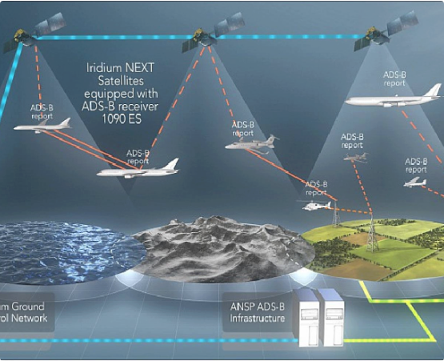
Space-Based Surveillance
Aireon / Iridium NEXT
Placing receivers on satellites enables global coverage, including oceans and poles.
>
The Challenge: Detecting low-power 1090MHz signals from 780km orbit.
>
The Value: Persistent tracking of high-value military assets in non-permissive environments.
Notes:
Goal: Discuss the game-changing shift to space-based ADS-B reception.
Notes:
The Challenge: Since ADS-B uses an omni-directional, low-power transmission, the signals were historically only picked up by ground stations. The vast majority of the Earth, particularly the oceans, was uncovered.
Aireon/Iridium NEXT: The solution was to place ADS-B receivers on Low Earth Orbit (LEO) satellites . This provided the first-ever global, persistent tracking capability.
Strategic Value: This is critical for monitoring high-value, long-haul military assets and detecting anomalies in non-permissive or remote environments.

Slide 21
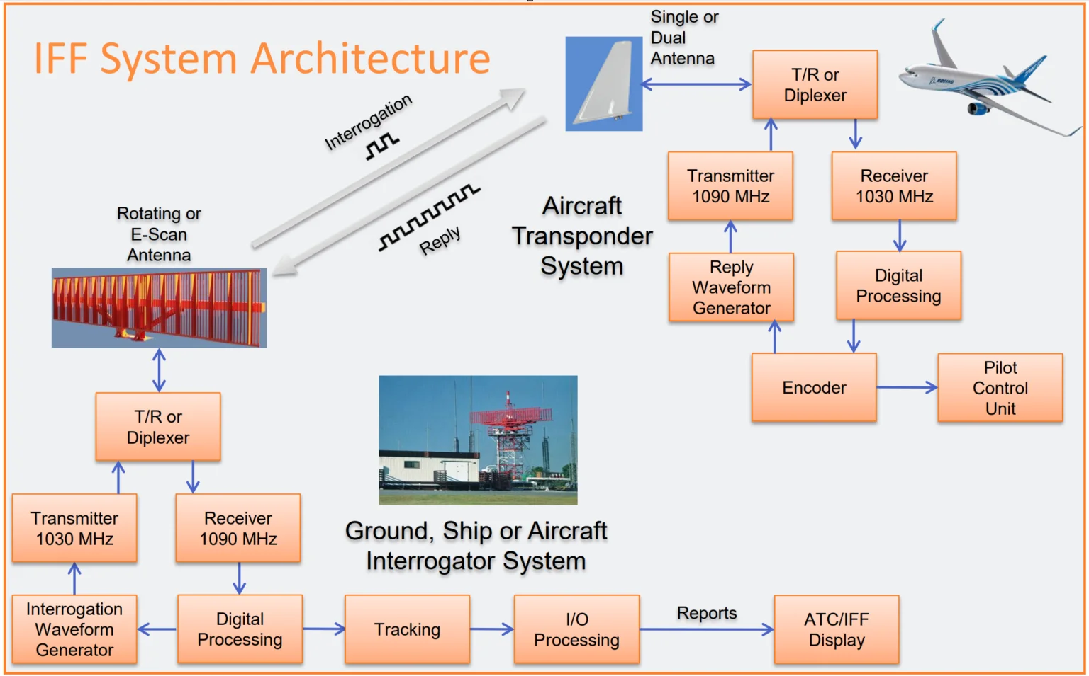
SSR/IFF System Architecture
>
Range: Determined by measuring the time between the interrogation reference pulse (P3 for SIF) and the time of receipt of the first framing pulse (F1) of the reply, minus the turnaround time of the transponder.
>
Azimuth: Two methods to determine:
The beam split method divides the received signal into multiple beams and analyzes their relative strengths to determine azimuth.
The monopulse method, which is about five times more accurate, uses a single antenna to measure azimuth based on the phase or amplitude differences of received signals.
Notes:
Goal: Discuss the game-changing shift to space-based ADS-B reception.
Notes:
The Challenge: Since ADS-B uses an omni-directional, low-power transmission, the signals were historically only picked up by ground stations. The vast majority of the Earth, particularly the oceans, was uncovered.
Aireon/Iridium NEXT: The solution was to place ADS-B receivers on Low Earth Orbit (LEO) satellites . This provided the first-ever global, persistent tracking capability.
Strategic Value: This is critical for monitoring high-value, long-haul military assets and detecting anomalies in non-permissive or remote environments.

Slide 22


Concept of Operations: IN vs OUT
ADS-B OUT (Tx)
ADS-B IN (Rx)
Mandatory. The aircraft broadcasts its state vector.
Situational Awareness. Cockpit receives data.
>
Position (Lat/Lon)
>
Velocity Vector
>
TIS-B: Traffic Information (uplink of non-ADS-B targets).
>
Baro & Geo Altitude
>
FIS-B: Flight Information (Weather) - UAT Only.
>
Flight ID / Callsign
Notes:
Goal: Differentiate between transmitting (OUT) and receiving (IN).
Notes:
ADS-B OUT (Transmit): This is the mandatory function. The aircraft broadcasts its state vector: Position, Velocity, Altitude, and Flight ID. This is how the ground and other aircraft track it.
ADS-B IN (Receive): This is the situational awareness function. The cockpit receives the data.
TIS-B (Traffic): Uplinked data showing traffic that isn't ADS-B equipped (tracked via SSR).
FIS-B (Flight Information): Uplinked weather information (UAT only).

Slide 23
SECTION 3
TECHNICAL DEEP DIVE
Protocols, Packets, and Physics
Notes:
Goal: Transition to the detailed protocol level.
Notes: Now we'll look under the hood—the physical layer, the message format, and the complex encoding used to pack high-precision data into small radio packets.

Slide 24

1090ES Physical Layer
Pulse Position Modulation (PPM)
ADS-B uses standard SSR frequencies but modifies the modulation.
>
Carrier: 1090 MHz ± 1 MHz
>
Modulation: PPM. Data encoded by pulse position within a 1µs time slot.
>
Message Length: 112 bits (Extended Squitter).
Notes:
Goal: Explain the modulation technique.
Notes:
While 1090ES uses the same frequency as SSR replies, it uses a different modulation technique called Pulse Position Modulation (PPM).
PPM: Instead of using the amplitude or frequency to encode data, PPM encodes a '1' or '0' based on where the pulse occurs within a 1-microsecond time slot.
Message: The final "Extended Squitter" message is 112 bits long.

Slide 25





The 112-Bit Payload
Breakdown of a Downlink Format 17 (DF17) Message:
ICAO Address
Data Field
Parity
Unique 24-bit hex code. Ex: AE1D34 (US Mil).
Contains Position, Velocity, or ID. Defined by Type Code (1-31).
CRC checksum. Critical for signal integrity in noisy RF environments.
Notes:
Goal: Break down the structure of a standard DF17 ADS-B message.
Notes:
The 112-bit message is segmented logically:
DF/CA: Downlink Format and Capability (5 bits, 3 bits). Defines the type of message (e.g., position, velocity, identification).
ICAO Address: A unique 24-bit hex code assigned to the airframe (e.g., AE1D34). This is the permanent identifier.
Data Field: The main payload (56 bits), containing the actual position, velocity, or flight ID information.
Parity/PI: A 24-bit Cyclic Redundancy Check (CRC) used for error detection. This is essential for reliability in noisy L-Band RF environments.

Slide 26

Compact Position Reporting (CPR)
Problem: 56 bits is too small for high-precision global Lat/Lon.
Solution: CPR uses "Odd" and "Even" frames.
>
Global Ambiguity: A single frame has multiple valid locations on Earth.
>
Resolution: Receiving both Odd and Even frames resolves the position globally.
>
Local Decoding: If the receiver knows the approximate location, one frame suffices.
Notes:
Goal: Explain how high-resolution position data fits into the limited 56-bit space.
Notes:
The Problem: Standard Latitude/Longitude coordinates require more bits than the 56-bit data field allows for high precision.
The Solution: CPR is a compression scheme that exploits the short-term continuity of an aircraft's flight path. It uses two frames—an Odd frame and an Even frame.
Resolution: Each frame alone has multiple possible locations (global ambiguity). When a receiver has both an Odd and an Even frame, it can mathematically resolve the true position with high precision.
Compact Position Reporting (CPR) is a crucial algorithm in the ADS-B (Automatic Dependent Surveillance-Broadcast) system that encodes and decodes aircraft position data to reduce message size. It works by dividing the Earth's surface into a grid of zones and transmitting the location as a fraction of the zone, using 17 bits for latitude and 17 bits for longitude. To overcome the ambiguity of a single message, two complementary "even" and "odd" messages are transmitted alternately, and the combination of these two messages allows for a precise and unambiguous position to be determined.
Encoding: CPR encodes the fractional part of the position within a zone. The full position is represented by a 17-bit "coarse" part (encoded in one message) and a 17-bit "fine" part (encoded in the other message).
Decoding: To decode, a receiver must receive both the "even" and "odd" messages. The receiver uses the "coarse" part of the message to determine the correct zone and the "fine" part to determine the precise location within that zone.
Ambiguity: Without receiving both messages, the position is ambiguous because the "coarse" part alone could place the aircraft in any one of the zones that share the same "fine" part.
Message types: CPR is used for different types of messages, with the number of "fine" parts (nb) varying based on the message type. For example, nb is 12 for "coarse," 14 for "intent," 17 for "airborne," and 19 for "surface".

Slide 27
Trust Metrics: NIC/NAC/SIL
Parameter | Definition | Impact
NIC (Nav Integrity) | Containment Radius. "I am within X miles." | Determines separation standards.
NACp (Nav Accuracy) | Estimated Position Uncertainty (95%). | Surveillance quality.
SIL (Source Integrity) | Probability of exceeding NIC radius. | Safety certification level.
Notes:
Goal: Define the metrics used to determine the trustworthiness of the reported position.
Notes: Because ADS-B is dependent (relying on the onboard GPS), Air Traffic Control needs confidence in the data. These three metrics, reported by the aircraft, determine that confidence:
NIC (Navigation Integrity): A radius that defines the maximum possible error ("I am definitely within X distance"). This is crucial for determining separation standards.
NACp (Navigation Accuracy): The 95% certainty boundary for the position estimate.
SIL (Source Integrity): The probability that the system will fail and report a position outside the NIC containment radius. This is a safety certification level.

Slide 28


Geometric vs Barometric Altitude
Barometric (Mode C)
Geometric (GNSS)
Based on air pressure (29.92 inHg baseline).
True height above the WGS84 ellipsoid.
ATC separates planes based on pressure levels, not true height.
Used for GPWS and verifying baro-altimeter errors.
Notes:
Goal: Explain the two different altitude types and their operational significance.
Notes:
Barometric (Pressure) Altitude: This is based on air pressure relative to a standard atmosphere setting (29.92 inHg). It is critical for vertical separation because ATC separates planes based on pressure levels, not true height, ensuring everyone is working from the same baseline.
Geometric (GNSS) Altitude: This is the true height above the Earth's WGS84 ellipsoid (GPS altitude). It is critical for terrain avoidance systems like GPWS and for verifying errors in the barometric system.

Slide 29

Timeline
1940s–50s: PSR introduced
1950s–60s: SSR with Mode A/C
1980s: Mode S development
1990s: ADS-B concept proven
2000s: Trials & ICAO adoption
2020+: ADS-B mandatory in U.S. / Europe
Notes:
Goal: Explain planning behind implementation

Slide 30
SECTION 4
MILITARY & INTELLIGENCE
OSINT, OpSec, and Electronic Warfare
Notes:
Goal: Transition to the intelligence and security implications of cooperative systems.
Notes: We've established the technology. Now we look at the vulnerabilities and strategic opportunities ADS-B and its maritime equivalent, AIS, present to intelligence and military operations.

Slide 31
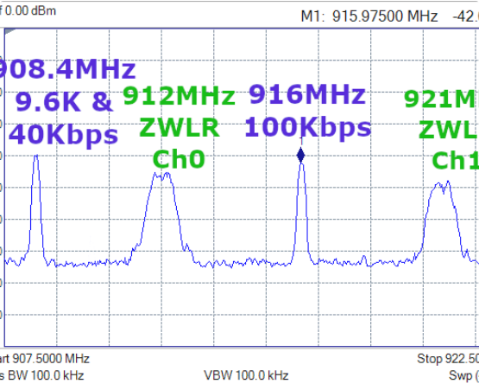
Vulnerability: No Authentication
The "Open Mic" Problem
ADS-B has NO Encryption and NO Authentication.
>
Eavesdropping: $20 SDRs can track all traffic.
>
Spoofing: Injecting fake DF17 messages to create "Ghost" aircraft.
>
Jamming: 1090 MHz is susceptible to high-power CW jamming.
Notes:
Goal: Identify the most significant security flaw in ADS-B.
Notes:
ADS-B was designed for safety, not security. It has NO encryption and NO authentication. Implications: This creates the "Open Mic" problem:
Eavesdropping: Anyone with a cheap Software Defined Radio (SDR) can passively track traffic.
Spoofing: An adversary can synthesize and broadcast fake DF17 messages, creating non-existent "Ghost" aircraft.
Jamming: High-power continuous wave (CW) transmissions can overwhelm the 1090 MHz frequency, denying service to legitimate receivers.
GPS jamming: Newark Liberty International Airport in New Jersey in 2009, Denver International, 2022, Dallas 2022, dozens of cases in Norway, Finland, etc
A real-world example of ADS-B spoofing occurred in 2015 when a hacker demonstrated the ability to control an aircraft's navigation system to change its ADS-B broadcast, causing it to appear in a different location.
Attack methodology
GPS spoofing: A separate attack method, GNSS spoofing, uses a software-defined radio (SDR) to broadcast fake GPS signals that make the aircraft's onboard navigation system believe it is at a false location.
Transponder tampering: Malware can be installed on an aircraft's transponder to generate misleading ADS-B messages.

Slide 32

Counter-Measure: MLAT
Multilateration (MLAT) verifies position via TDOA (Time Difference of Arrival).
Concept
Verification
Limitation
If 4+ ground stations hear the signal, position can be triangulated geometrically.
If GPS report != MLAT result, the target is flagged as SPOOFED.
Requires dense ground infrastructure. Fails over open ocean.
Notes:
Goal: Explain how Multilateration defends against spoofing.
Notes:
MLAT (Multilateration): This technique is used to verify the reported ADS-B position.
TDOA: It uses the Time Difference of Arrival (TDOA) of the ADS-B signal at multiple ground stations (four or more are ideal) to calculate the signal's origin geometrically.
Verification: If the position reported in the ADS-B packet (the GPS position) does not match the MLAT-calculated position, the target is immediately flagged as spoofed.
Limitation: MLAT requires a dense network of receivers, so it fails over the open ocean where spoofing is an easier tactic.

Slide 33

OSINT Flight Tracking
Democratized Surveillance
Aggregators (ADS-B Exchange) rely on volunteer feeders, bypassing military filters.
"If it transmits, we can see it."
>
Impact: Military movements visible in real-time.
>
Intelligence: Troop deployments, VIP travel, and surveillance orbits inferred from open data.
Notes:
Goal: Discuss the impact of open-source intelligence on military operations.
Notes:
The existence of ADS-B Exchange and similar aggregators has democratized surveillance.
Volunteer feeder networks allow anyone to track aircraft globally, bypassing official military filtering.
Intelligence Impact: Adversaries can monitor military movements, infer troop deployments, track VIPs, and analyze surveillance orbits simply by using open data.

Slide 34
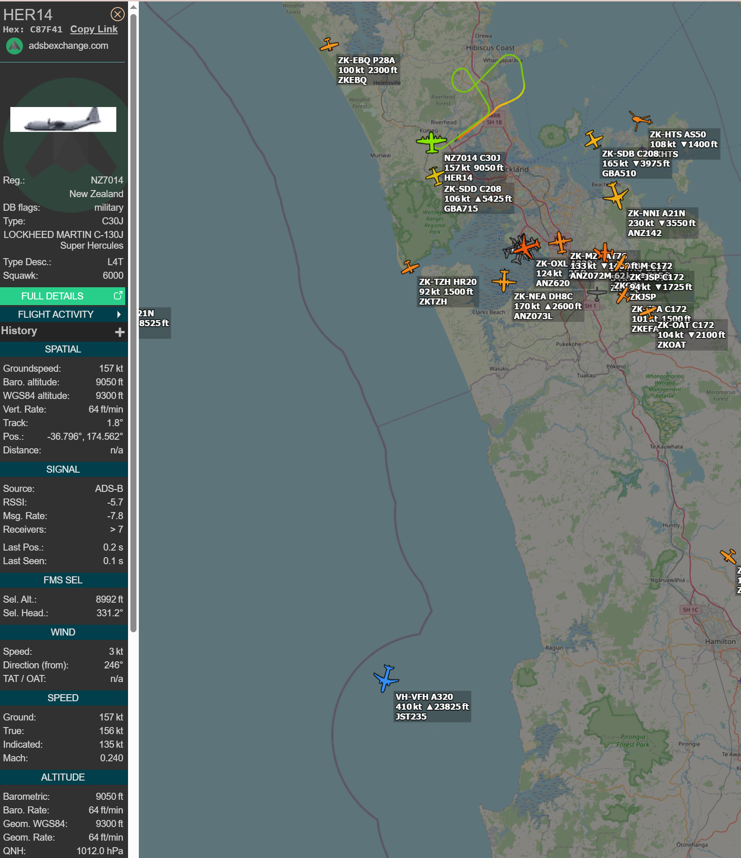
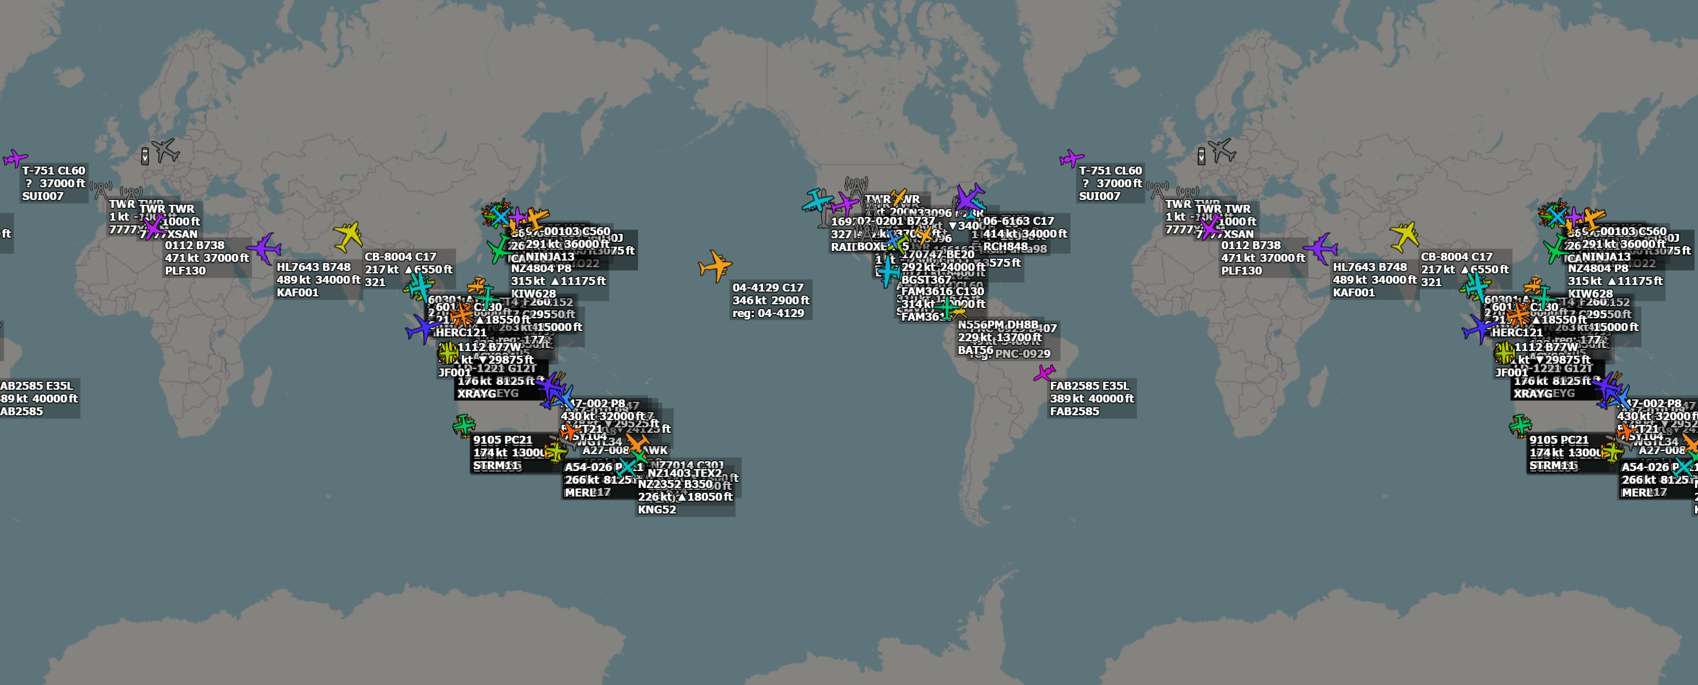

Aggregators view of the world
Military planes – selected by the type of planes reported by onboard ADS-B systems
Notes:
Goal: Discuss the impact of open-source intelligence on military operations.
Notes:
The existence of ADS-B Exchange and similar aggregators has democratized surveillance.
Volunteer feeder networks allow anyone to track aircraft globally, bypassing official military filtering.
Intelligence Impact: Adversaries can monitor military movements, infer troop deployments, track VIPs, and analyze surveillance orbits simply by using open data.

Slide 35

Operational Security (OpSec)
Pattern of Life
Hex Code Correlation
Base Discovery
Long-term analysis reveals SOPs, patrol routes, and shift changes.
Static 24-bit Hex addresses link specific airframes to specific units, even if callsigns change.
Aggregated heatmaps can reveal sensitive forward operating locations (the "Strava Effect").
Notes:
Goal: Detail the specific OpSec risks posed by ADS-B data.
Notes:
Pattern of Life (POL): Long-term data aggregation reveals established operating procedures (SOPs), regular patrol routes, and predictable schedules, making assets vulnerable to pre-planned strikes.
Hex Code Correlation: The 24-bit ICAO address is static. Even if an airframe changes its mission and callsign, its permanent Hex code links it back to its unit and history.
Base Discovery: Aggregating flight heatmaps (the "Strava Effect") can reveal the precise location of sensitive, unofficial, or classified forward operating locations.

Slide 36
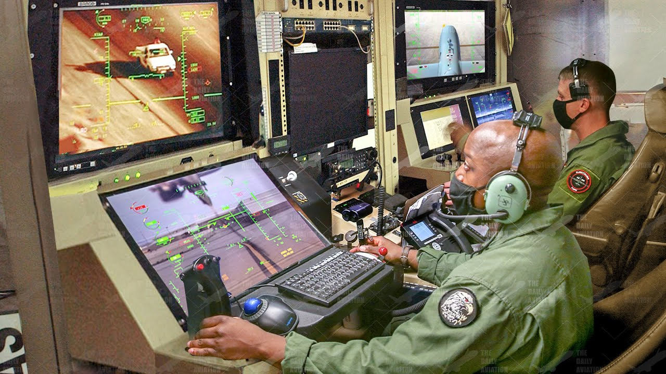
Why Militaries Use ADS-B
>
Safety: Collision avoidance in crowded civilian airspace.
>
Overt Presence: "Showing the Flag" (e.g., Global Hawk over Black Sea).
>
Efficiency: Allows use of optimal civilian flight levels.
Notes:
Goal: Explain why military assets willingly broadcast their position.
Notes:
Despite the OpSec risks, militaries use ADS-B for several reasons\
Safety: To comply with civilian airspace regulations and prevent collisions, especially during transit or while operating near commercial lanes.
Overt Presence: Intentionally "showing the flag" to signal presence or intent (e.g., surveillance missions over contested regions).
Efficiency: Allows assets to use optimal civilian flight levels and routes for fuel efficiency.

Slide 37
Tactical Mode Management
Mode | Description | Use Case
Mode S / ADS-B ON | Full broadcast of position/ID. | Transit, Training, Overt Ops.
Mode 3/A Only | Squawk code only. No position broadcast. | Tactical Ops requiring deconfliction but limited tracking.
RF Silent / EMCON | Transponder OFF. | Combat missions, Stealth.
Notes:
Goal: Show how militaries manage their electronic signature.
Notes: Transponder usage is a critical tactical decision:
Mode S / ADS-B ON: Full broadcast. Used for transit, training, or operations where visibility is required.
Mode 3/A Only: Broadcasts only the Squawk code (4 digits), but not the GPS position. Used for tactical operations that need some air traffic deconfliction but desire limited tracking.
RF Silent / EMCON: All cooperative systems are OFF. Used for combat missions, infiltration, or stealth, relying solely on passive surveillance or PSR for protection.

Slide 38

Electronic Warfare: Ghost Fleets
The Circle Hack
Adversaries spoofing circular flight paths over sensitive areas.
>
Technique: High-power SDR transmission of synthesized DF17 packets.
WARNING
Spoofed data can pollute the Common Operating Picture (COP) if ingested without verification.
>
Goal: Desensitize air defenses or mask infiltration.
>
Detection: Perfect geometric circles or impossible physics (Mach 5 turns).
Notes:
Goal: Detail the active EW threat of spoofing.
Notes:
The Hack: Adversaries use high-power Software Defined Radio (SDR) transmitters to inject fabricated ADS-B messages (DF17 packets) into the system.
The Circle: A common pattern involves spoofing aircraft in perfect circular holding patterns over sensitive areas.
Goal: The primary goal is to mask legitimate infiltration by flooding the COP with false contacts or simply confusing air defense systems.
Detection: Spoofing is typically detected by observing impossible physics (Mach 5 turns) or when MLAT verification fails.

Slide 39
UAS and Detect & Avoid
DAA Logic
Virtual Hijack
Low Power
Drones use ADS-B IN to automatically maneuver away from traffic.
Spoofing a collision course could force a drone to alter course into a denial area.
Small UAS use 978 UAT, harder to detect from orbit but visible locally.
Notes:
Goal: Discuss the ADS-B role in Unmanned Aerial Systems (UAS).
Notes:
DAA (Detect and Avoid): ADS-B IN is a core technology for medium to large drones, allowing them to automatically sense and maneuver away from nearby traffic.
EW Threat: The potential for a virtual hijack exists: spoofing a synthetic collision course could force the UAS to deviate into an air defense zone or denied area.
Smaller, low-power UAS often use the 978 UAT frequency, making them harder to detect from space but still visible to local receivers.

Slide 40
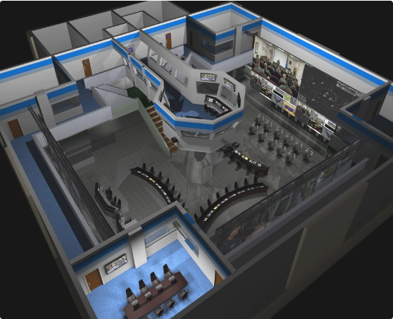
Future Tech: LPI/LPD
Low Probability of Intercept/Detection. How to communicate without being a target?
>
Directional Datalinks: MADL (F-35) uses narrow beams, not omni-directional.
>
Burst Transmission: Microsecond bursts to evade scanners.
Notes:
Goal: Introduce the future direction of electronic signature management.
Notes:
Future systems are focused on LPI/LPD (Low Probability of Intercept/Detection) .
Directional Datalinks (e.g., MADL): Unlike ADS-B, which broadcasts omni-directionally, these systems use narrow, tightly focused beams to communicate with specific receivers.
Burst Transmission: Transmitting data in high-power, microsecond-long bursts makes it extremely difficult for conventional scanners and spectrum analyzers to detect, track, and locate the source.

Slide 41
SECTION 5
THE MARITIME PARALLEL
Automatic Identification System (AIS)
Notes:
Goal: Transition to the sea domain and the AIS system.
Notes: Everything we've discussed for air surveillance has a direct parallel in the maritime world, which uses the Automatic Identification System, or AIS.

Slide 42
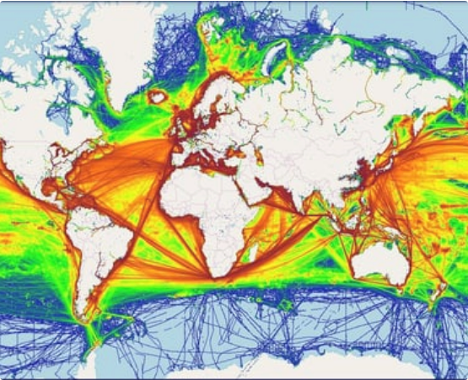
Global Maritime Traffic
AIS: The Sea's ADS-B
Developed independently for collision avoidance. Mandatory for vessels >300GT.
>
Frequency: VHF (162 MHz).
>
Range: Over the horizon (ducting).
>
Access: SOTDMA (Time Slots).
Notes:
Goal: Introduce AIS and its core difference from ADS-B.
Notes:
Purpose: AIS was also developed for collision avoidance. It is mandatory for vessels over 300 gross tonnage.
Frequency: It uses the VHF marine band (162 MHz), a much lower frequency than ADS-B's L-Band.
Protocol: It uses SOTDMA (Self-Organizing Time Division Multiple Access), which is a key difference.

Slide 43
Tech Spec: ADS-B vs AIS
Feature | ADS-B (Air) | AIS (Sea)
Spectrum | L-Band (1090 MHz) | VHF (162 MHz)
Access | Random Aloha (CSMA) | SOTDMA (Time Slots)
Update | High (2 Hz) | Low (2s to 3 mins)
Notes:
Goal: Compare the fundamental differences in the two systems.
Notes: Key takeaways from this comparison:
Frequency: AIS's lower VHF frequency gives it better long-distance propagation (ducts/over the horizon) but limits bandwidth. ADS-B's 1090 MHz is better for high-speed, high-density traffic.
Access Method: This is the most crucial difference. ADS-B uses random access (CSMA), which leads to collisions in high-density areas. AIS uses SOTDMA, where ships reserve their time slots, which is more organized and resilient to congestion.
Update Rate: AIS is much slower (seconds to minutes) because maritime movement is inherently slower than air travel.

Slide 44
SOTDMA Protocol
Concept
Benefit
Satellite Issue
Ships reserve future time slots. "I will transmit in 30s on slot #405."
Prevents packet collisions in crowded ports. More organized than ADS-B.
SOTDMA fails in space because satellites see thousands of ships that can't hear each other.
Notes:
Goal: Detail the key innovation of the AIS protocol.
Notes:
Concept: SOTDMA is self-organizing. Ships communicate to each other, saying, "I will transmit my data in time slot #X at time T." This reservation prevents collisions.
Benefit: It handles the high congestion of busy ports and straits very effectively.
Limitation in Space: This system breaks down when viewed from a satellite because the satellite can see thousands of ships that cannot hear each other's slot reservations, leading to data collisions.

Slide 45


AIS Message Content
Dynamic Data
Static/Voyage Data
Updates frequently based on speed.
Updates every 6 mins.
•
Position (Lat/Lon)
•
MMSI & IMO Number
•
COG / SOG
•
Callsign & Name
•
Rate of Turn
•
Destination & ETA
•
Draft & Cargo
Notes:
Goal: Break down what information is transmitted over AIS.
Notes: AIS transmits two main types of data:
Dynamic Data: Updates frequently based on vessel speed and maneuvering. This includes position, Course Over Ground (COG), Speed Over Ground (SOG), and Rate of Turn.
Static/Voyage Data: Updated less frequently (every 6 minutes or when voyage changes). This is the key identity information: the ship's unique MMSI and IMO numbers, the vessel's name, destination, and cargo details. This static information is critical for identifying non-compliant vessels.

Slide 46
The Maritime "Dark Fleet"
Gap Events
MMSI Spoofing
Fusion Need
Ships turning off AIS near sanctions zones (Iran, NK).
Multiple ships broadcasting the same ID.
Detecting these requires correlating the absence of signal with other sensors (SAR/Optical).
Notes:
Goal: Introduce the threat and challenges of non-cooperative maritime targets.
Notes:
Gap Events: The primary anomaly is the "gap event," where a vessel's AIS is suddenly turned off, often right before entering a sanctions zone or engaging in illicit activity (e.g., off the coast of Iran or North Korea).
MMSI Spoofing: Vessels may broadcast a legitimate but false ID belonging to another ship.
Fusion Need: Because ships can be tracked by other sensors (like SAR satellites), detecting a "dark ship" requires a fusion model that correlates the absence of an AIS signal with the presence of a non-cooperative radar contact.

Slide 47
SECTION 6
MULTI-INT FUSION
Integrating Air, Sea, and Space
Notes:
Goal: Transition to the synthesis of the data streams.
Notes: This is the payoff of the briefing. We move from individual surveillance sources to the true power of Multi-INT: correlating cooperative air and sea data with non-cooperative sources.

Slide 48


The Power of Fusion
Layer 1: ADS-B
Layer 2: AIS
Layer 3: Fusion
Shows location of patrol aircraft and drones.
Shows declared location of merchant traffic.
Reveals interactions. Why is that cargo plane circling that fishing boat?
Notes:
Goal: Demonstrate the synergistic value of combining data layers.
Notes:
Layer 1 (ADS-B): Tells us where the surveillance assets (drones, patrol aircraft) are.
Layer 2 (AIS): Tells us the declared location and identity of merchant traffic.
Layer 3 (Fusion): By correlating the two, we reveal interactions—the anomalies. For example, why is a high-value cargo aircraft (seen on ADS-B) performing a tight, low-altitude orbit over an undeclared vessel (seen only on SAR/Optical) or a fishing vessel (seen on AIS)?

Slide 49
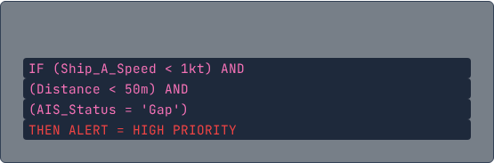
Use Case: Sanctions & STS
Ship-to-Ship (STS) Transfers
Logic Chain
>
Logic: Two tankers with "Gap" events in same quadrant.
>
Fusion: Optical imagery confirms proximity.
>
Validation: ADS-B shows P-8 Poseidon loitering overhead.
Notes:
Goal: Provide a concrete example of fusion solving a sanctions-busting scenario.
Notes:
The Tactic: Ship-to-Ship (STS) transfers are used to conceal the origin or destination of illicit cargo (like sanctioned oil). Both tankers involved turn off their AIS (Gap event).
Fusion Chain:
Alert on two ships having simultaneous "Gap" events in the same general area.
Use SAR/Optical Imagery to confirm they are physically close (Distance < 50m).
Use ADS-B to validate that a patrol aircraft was loitering overhead, indicating known intelligence interest.
Logic: The algorithm combines the speed, proximity, and AIS status to flag a high-priority STS transfer alert.

Slide 50
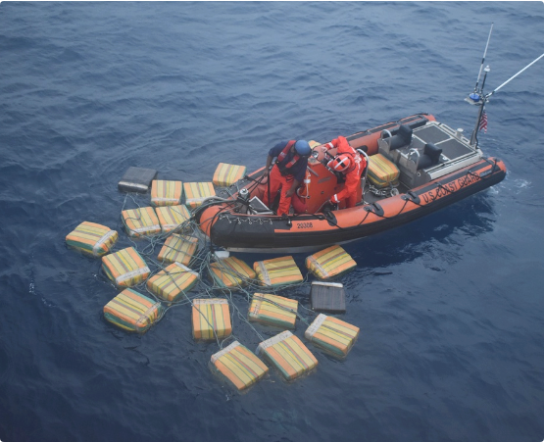
Use Case: Narco-Trafficking
The Air-Sea Handoff
>
ADS-B Anomaly: GA aircraft flying low over ocean, then climbing.
>
AIS Void: Go-Fast boats don't use AIS.
>
Fusion: Correlate aircraft loiter with Sentinel-1 SAR hits.
Notes:
Goal: Provide an example of Air-Sea handoff detection.
Notes:
The Tactic: Small planes or go-fast boats are used for transfer, and neither use required cooperative systems.
Fusion Chain:
ADS-B Anomaly: Detect a General Aviation aircraft flying an unusual, low-altitude profile far out over the ocean, followed by a gap.
AIS Void: Go-fast boats are non-cooperative, but we can look for other non-cooperative signals.
SAR/Optical Correlate: Cross-reference the ADS-B anomaly with Synthetic Aperture Radar (SAR) hits from Sentinel-1 or similar satellites, which are excellent at spotting fast-moving small objects on the water surface.

Slide 51
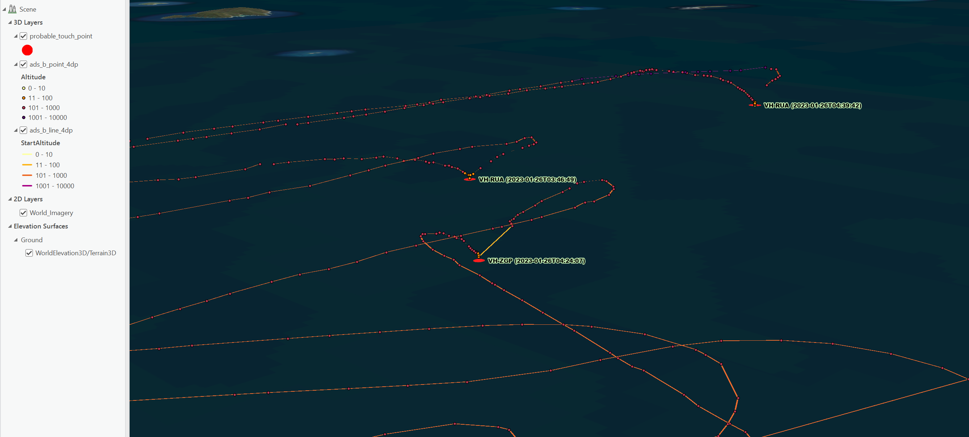
Analyzing the "Gap" (cont)
Dark vessels visited by a helicopter
>
Aircraft transponders provide continuous ADS-B broadcasts (position, altitude, callsign).
>
Helicopters servicing offshore vessels create repeatable approach–landing–takeoff patterns.
>
When AIS is absent, ADS-B landings on unknown lat/long clusters reveal hidden ship positions.
Notes:
Goal: Detail the analytical process of inferring activity during a period of signal loss.
Notes:
When a target goes "dark," analysts focus on the "gap" between the Loss of Signal (LOS) and the Acquisition of Signal (AOS) .
Interpolation: The simplest method is to draw a straight line.
Deviation: If the time gap would require the asset to travel at an impossible speed, it means they took a detour, suggesting a loitering event, a stop, or an illicit rendezvous.
Altitude Profile: For aircraft, a sudden, controlled descent just before the LOS indicates a potential landing at an undeclared location.

Slide 52
SECTION 7
THE PHYSICS OF DARKNESS
Air vs. Sea Detection Challenges
Notes:
Goal: Transition to the technical difficulty of detecting targets without cooperative signals.
Notes: This final section addresses the hardest problem in surveillance: what to do when targets adhere to full EMCON (Emission Control) and turn everything off.

Slide 53




Dark Air vs. Dark Sea
Dark Ships (Easier)
Dark Aircraft (Harder)
>
Speed: Slow (~20 kts). Hard to escape satellite windows.
>
Speed: Fast (Mach 0.8+). Gone before satellite revisits.
>
Physics: 2D Surface. Wakes are visible to SAR for miles.
>
Physics: 3D Maneuver. No wakes. Small Radar Cross Section (RCS).
>
Detection: Requires active Primary Radar (Ground/Airborne).
>
Detection: Sentinel-1 SAR is highly effective.
Notes:
Goal: Compare the difficulty of tracking non-cooperative targets in both domains.
Notes: The physics make one domain much easier than the other:
Dark Ships (Easier): Ships are slow and massive. Their wakes are highly visible to SAR satellites due to the physics of water surface distortion. They are also constrained to a 2D surface.
Dark Aircraft (Harder): Aircraft are fast and maneuverable in 3D. They leave no detectable wake. Their low Radar Cross Section (RCS) combined with high speed means they are gone before LEO satellites can re-task. Detection requires active primary radar coverage.

Slide 54
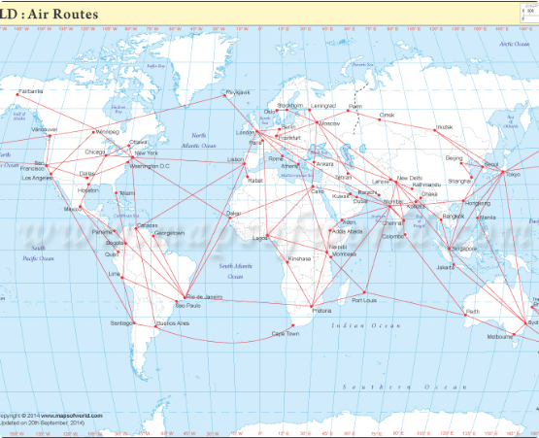
Analyzing the "Gap"
The "Loch Ness" Effect
When a target goes dark, we look for the gap.
>
Interpolation: Drawing a line between "Loss of Signal" (LOS) and "Acquisition of Signal" (AOS).
>
Deviation: If the time delta suggests impossible speed, they didn't fly straight—they made a detour (illicit stop).
>
Altitude Profile: Sudden descent before a gap often indicates landing.
Notes:
Goal: Detail the analytical process of inferring activity during a period of signal loss.
Notes:
When a target goes "dark," analysts focus on the "gap" between the Loss of Signal (LOS) and the Acquisition of Signal (AOS) .
Interpolation: The simplest method is to draw a straight line.
Deviation: If the time gap would require the asset to travel at an impossible speed, it means they took a detour, suggesting a loitering event, a stop, or an illicit rendezvous.
Altitude Profile: For aircraft, a sudden, controlled descent just before the LOS indicates a potential landing at an undeclared location.

Slide 55
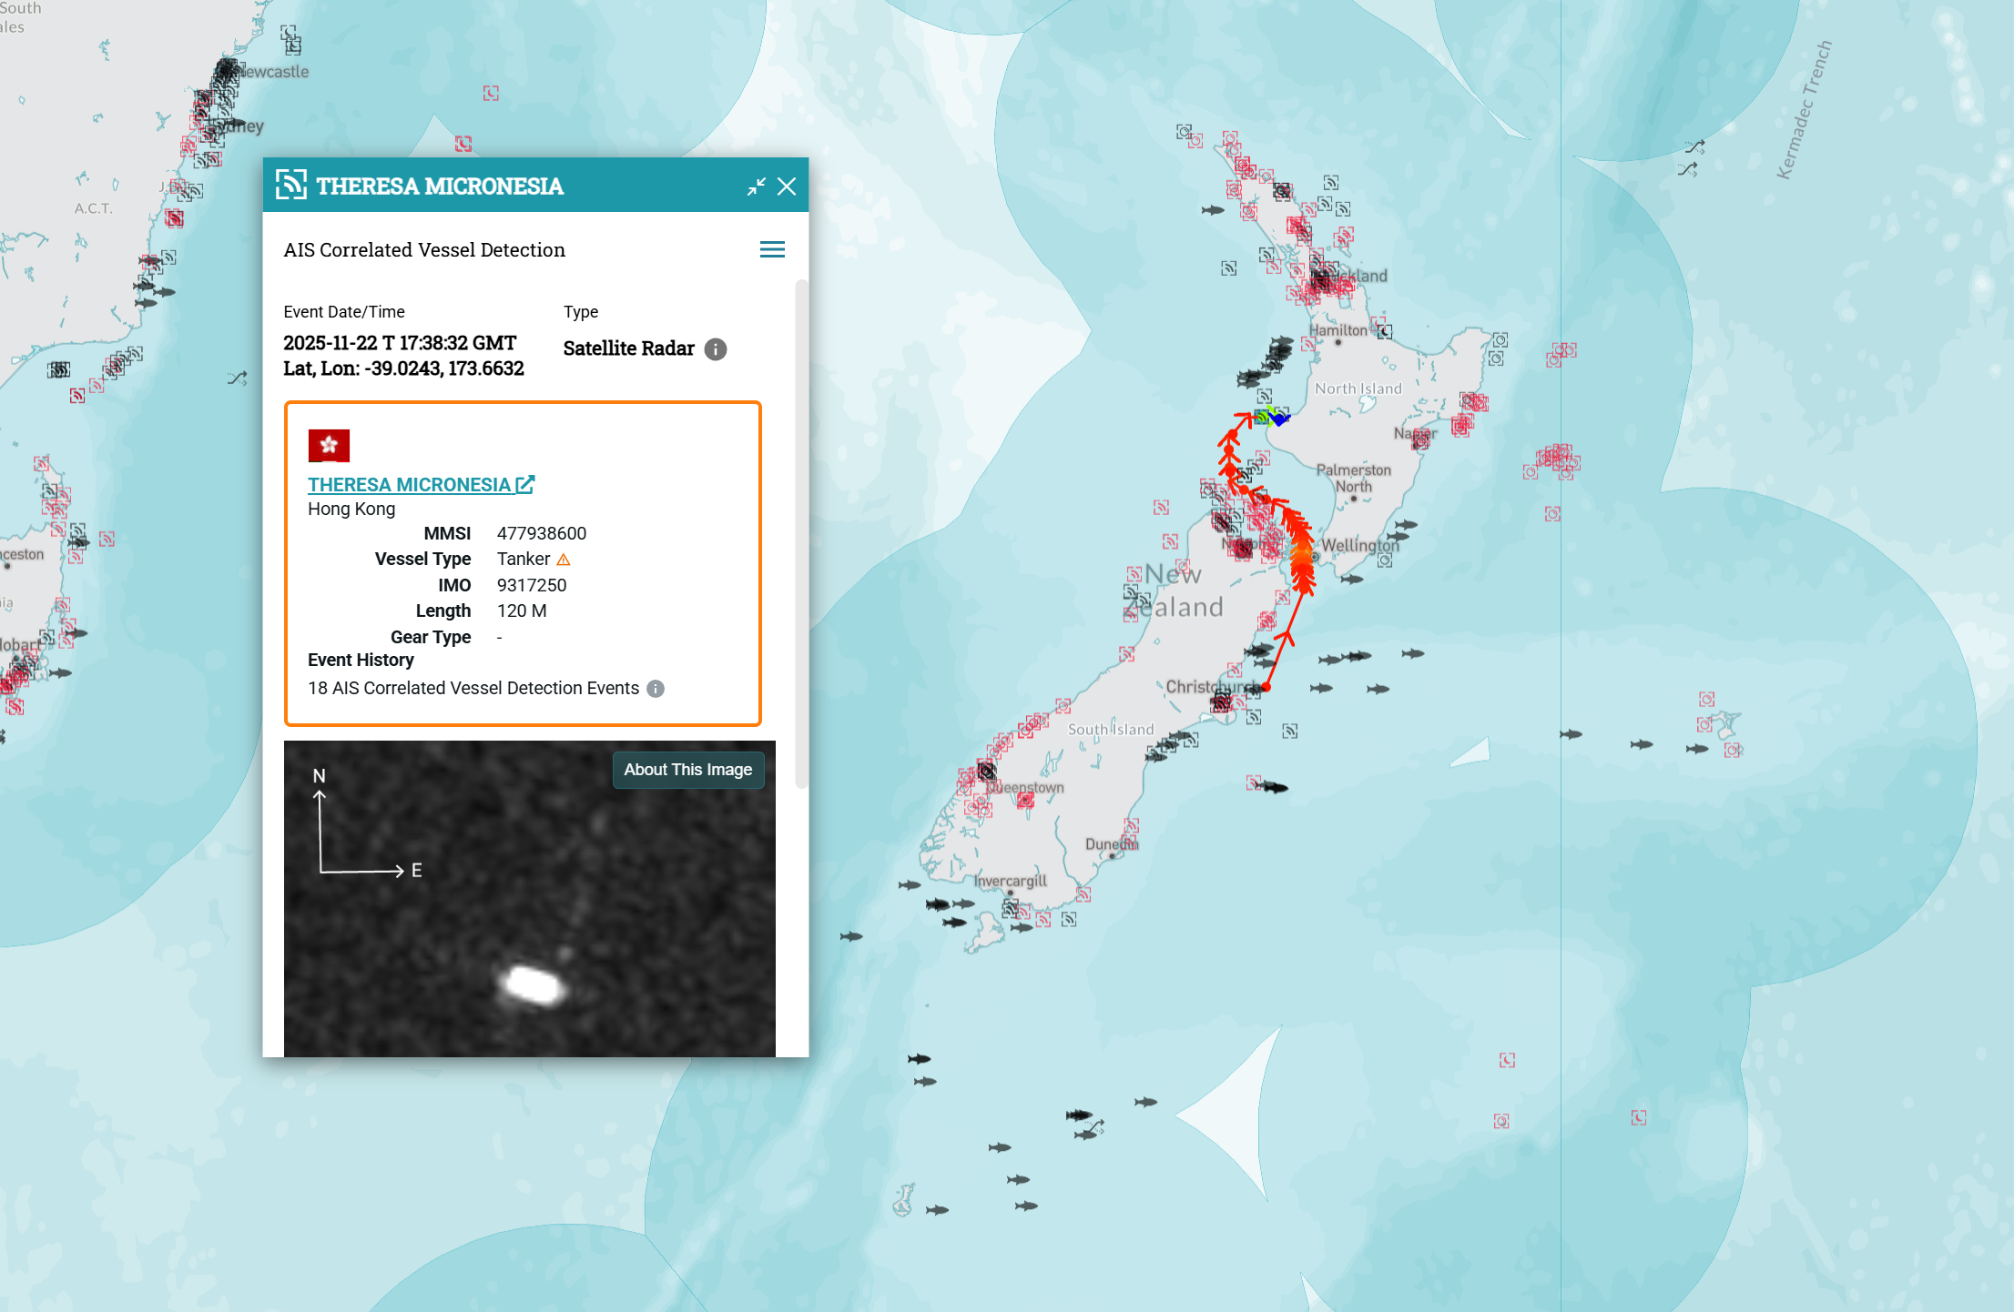

The SkyLight Paradigm
Automated Correlation
Modern MDA (Maritime Domain Awareness) tools like SkyLight automate the "Negative Space" equation.
The Algorithm
1. Ingest Satellite Radar (SAR) Feed. 2. Overlay AIS Data. 3. Identify Mismatch: "I see a ship on Radar, but no AIS signal." 4. Flag as Dark Target.
Notes:
Goal: Introduce the modern analytical fusion model for maritime targets.
Notes:
The SkyLight Paradigm (used by major data providers) formalizes the detection of dark ships.
The Algorithm: It works by correlating the positive and negative spaces:
Ingest the Active Satellite Radar (SAR) feed, which sees all ships.
Overlay the Cooperative AIS data, which sees only declared ships.
The Mismatch (SAR hit but no AIS signal) is automatically flagged as a high-priority "Dark Target" for further investigation via other means (e.g., optical imagery).

Slide 56
Pattern of Life Analysis
Establishing Baseline
ML Detection
Understanding normal routes (Air & Sea) to detect anomalies.
Machine Learning flags deviations, loitering, or draft changes at sea.
Notes:
Goal: Reiterate the importance of long-term data for anomaly detection.
Notes:
The key to finding a dark target is to first establish what is "normal" across both domains.
Establishing Baseline: Defining the normal operating parameters (speed, course, loitering areas) for a specific airframe or vessel type.
ML Detection: Machine Learning algorithms are employed to constantly monitor the live feed for deviations from this established pattern of life—a ship loitering when it normally transits, or a pilot changing altitude when they should be at a fixed flight level.

Slide 57




Final Summary
Radar Era
Digital Era
Physics-based detection. The "Safety Net."
ADS-B/AIS. High precision, but vulnerable to spoofing.
Dark Targets
Future
The frontier of surveillance. Requires sensor fusion.
AI-driven correlation of space-based sensors.
QUESTIONS?
Notes:
Goal: Conclude the presentation by summarizing the journey from radar to modern fusion.
Notes:
Radar Era: The origin of surveillance based purely on physics and echo. The original safety net.
Digital Era: ADS-B and AIS provided high precision and global coverage but introduced major security vulnerabilities (spoofing, OSINT).
Dark Targets: This is the current frontier. Non-cooperative targets require a multi-faceted approach.
Future: Success lies in the AI-driven correlation of all available sensors—cooperative broadcasts, passive RF intelligence, and active space-based radar—to create a unified, robust operating picture.

